Slide 1

SonarQube
Setting up Maven Project Jenkins & SonarQube
Presented By :
Amrit Choudhary

Slide 2

On boarding Maven projects
Pre- Requisites
Install Maven on your machine/remote host where Maven job would run.
https://maven.apache.org/download.cgi
Set environment variable MVN_HOME
Verify Maven version cmd: mvn –version
JDK 1.8 or higher
Verify java version cmd : java -version

Slide 3
Maven Phases

Slide 4
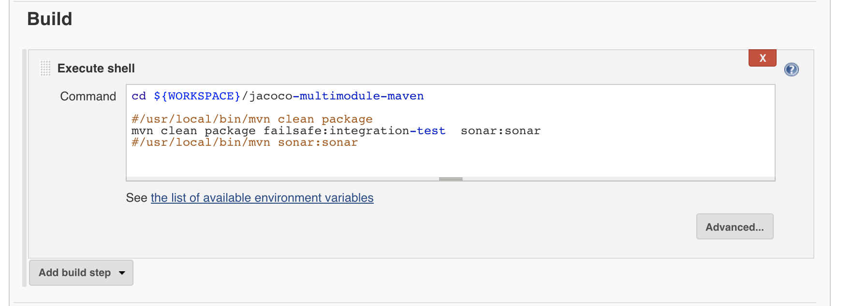
On boarding Maven project on Jenkins
Follow the Video & Snapshots for reference

Slide 5
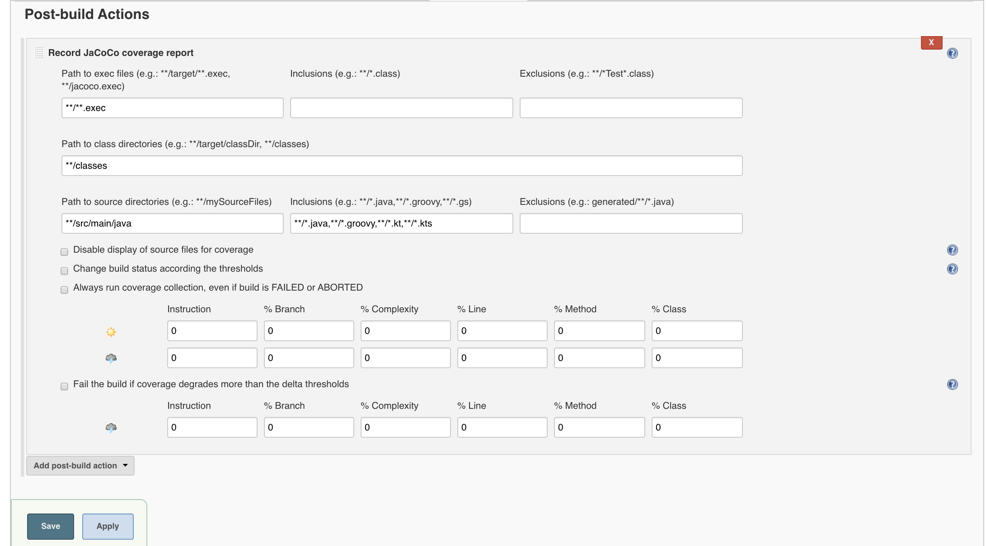
On boarding MAVEN project on Jenkins Post Build Actions, generate coverage Jenkins

Slide 6
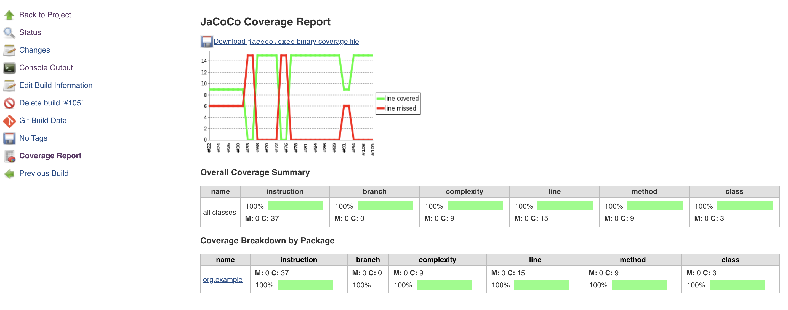
Jenkins Coverage : Display

Slide 7
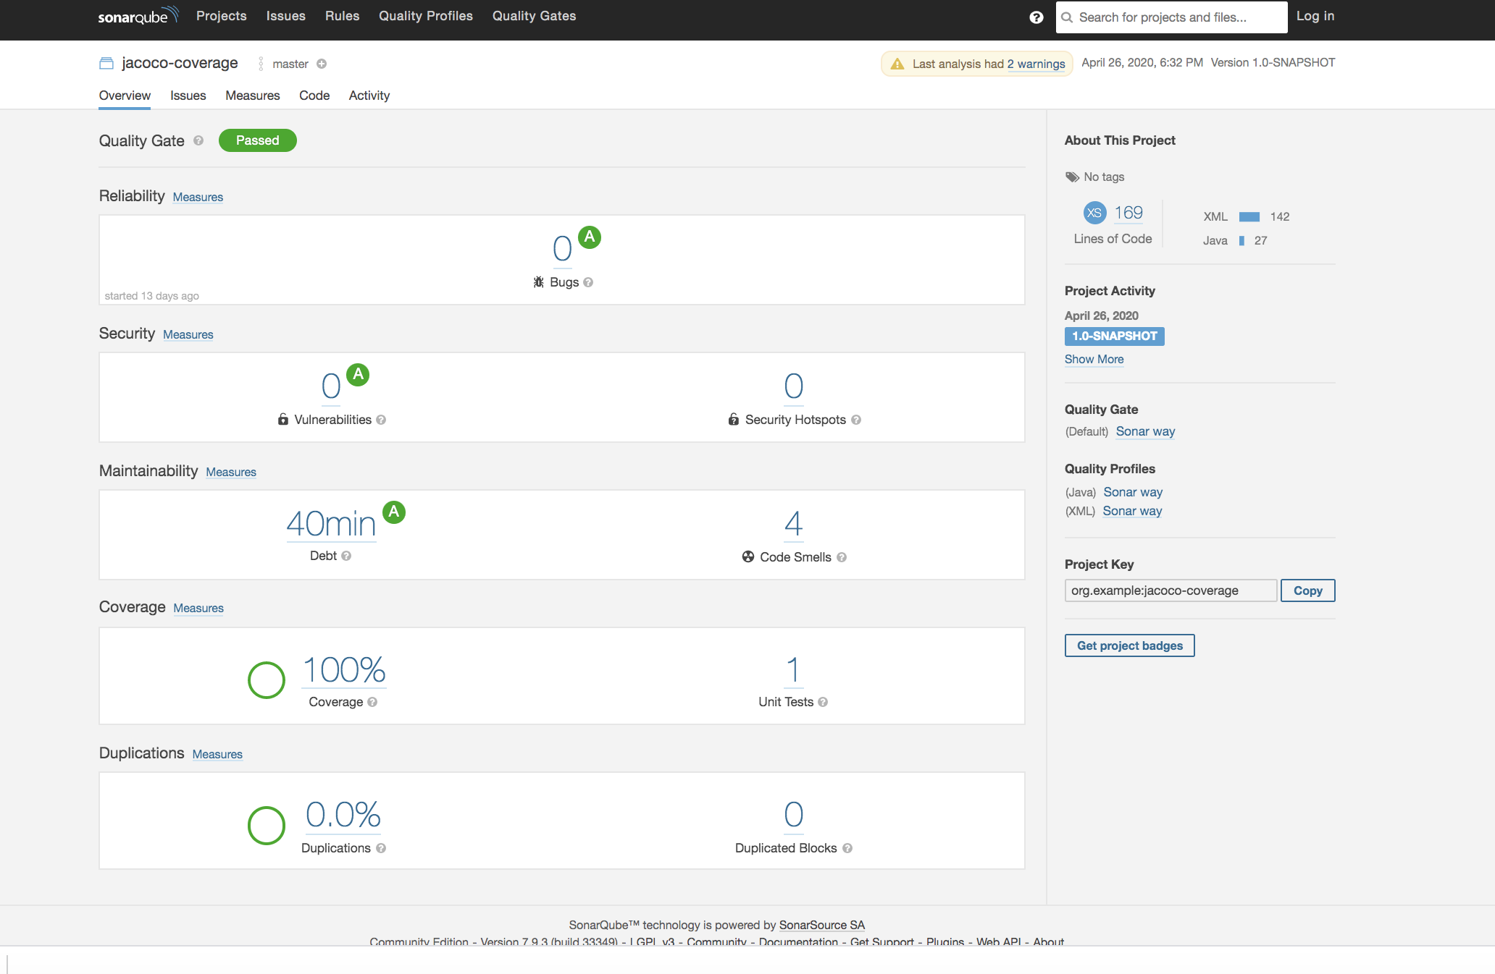
Run Jenkins Maven Job : Final Result SonarQube

Slide 8
Technical Debt
Financial | Technical
Cash buy | Ready for Market/Release
Pay instalments with Interest | Refactor again and again
Don’t have money to pay | Not able to maintain the exiting code

Slide 9
Congrats !!!
Maven Project is on boarded successfully.
Git repo for maven: https://github.com/trainmefordevsecops/maven-multi-module-project.git

